Slide 1
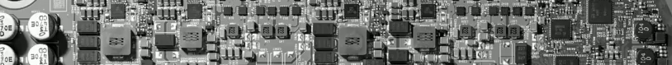

Real-Time Operating System (Day 2 Lab)
Jong-Chan Kim
Graduate School of Automotive Engineering

Slide 2
09. ButtonISR (06 복사해서 수정)
bsw.cpp 수정: 버튼 인터럽트 받을 수 있도록
OIL 수정: ButtonISR 추가
int main(void)
{
osEE_tc_stm_set_clockpersec();
osEE_tc_stm_set_sr0( 1000000U, 1U);
UART_init();
initADC();
initPeripheralsAndERU();
.
.
.
}
bsw.c
ISR ButtonISR {
CATEGORY = 2;
SOURCE = "SCUERU0";
PRIORITY = 10;
};

Slide 3
09. ButtonISR
ISR2(TimerISR)
{
static long c = -4;
if (c == 0)
ActivateTask(Task1);
printfSerial("\n%4ld: ", c++);
}
ISR2(ButtonISR)
{
DisableAllInterrupts();
osEE_tc_delay(5000);
printfSerial("<BUTTON ISR>");
// read ADC value
unsigned int a0 = readADCValue(3);
if (a0 < 50) { // UP
ActivateTask(Task1);
} else if (a0 < 200) { // DOWN
ActivateTask(Task2);
} else if (a0 < 380) { // LEFT
} else if (a0 < 520) { // RIGHT
}
osEE_tc_delay(3000);
EnableAllInterrupts();
}
asw.c

Slide 4
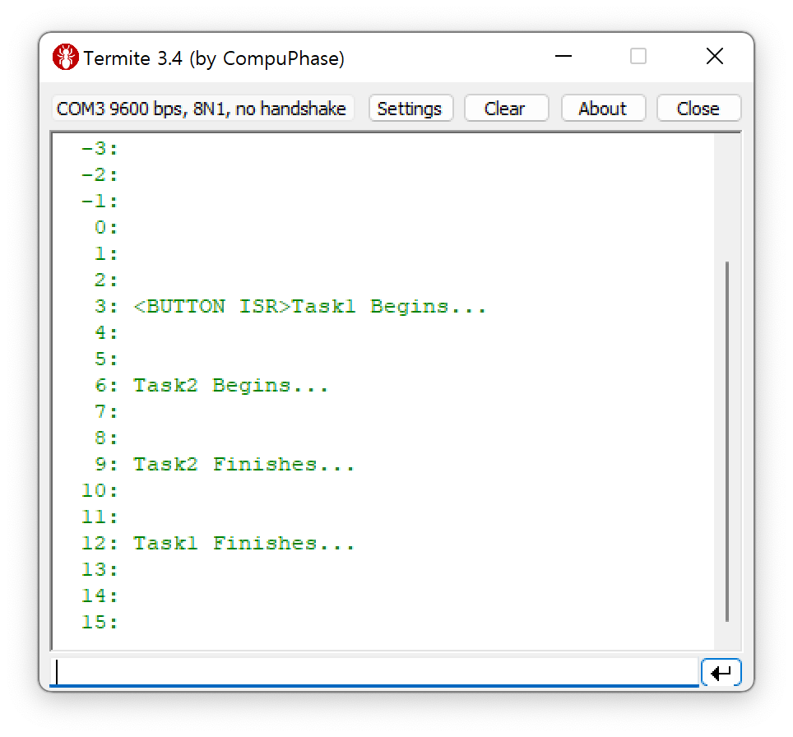
09. ButtonISR
중복 Activation의 경우?
ACTIVATION = 1; 수정 필요
ISR에서 mdelay 실행하면?
Nested Interrupt
ButtonISR 도중 TimerISR 실행

Slide 5
10. Alarm
OIL에 COUNTER와 ALARM 추가
COUNTER mycounter {
MINCYCLE = 1;
MAXALLOWEDVALUE = 127;
TICKSPERBASE = 1;
};
ALARM alarm1 {
COUNTER = mycounter;
ACTION = ACTIVATETASK {
TASK = Task1;
};
AUTOSTART = TRUE {
ALARMTIME = 5;
CYCLETIME = 10;
};
};
ALARM alarm2 {
COUNTER = mycounter;
ACTION = ACTIVATETASK {
TASK = Task2;
};
AUTOSTART = TRUE {
ALARMTIME = 5;
CYCLETIME = 20;
};
};

Slide 6
10. Alarm
TimerISR에서 counter1 증가
ISR2(TimerISR)
{
osEE_tc_stm_set_sr0_next_match(1000000U);
static long c = -4;
IncrementCounter(mycounter);
printfSerial("\n%4ld: ", c++);
}
TASK(Task1)
{
printfSerial("Task1 Begins...");
mdelay(3000);
printfSerial("Task1 Finishes...");
TerminateTask();
}
TASK(Task2)
{
printfSerial("Task2 Begins...");
mdelay(3000);
printfSerial("Task2 Finishes...");
TerminateTask();
}

Slide 7
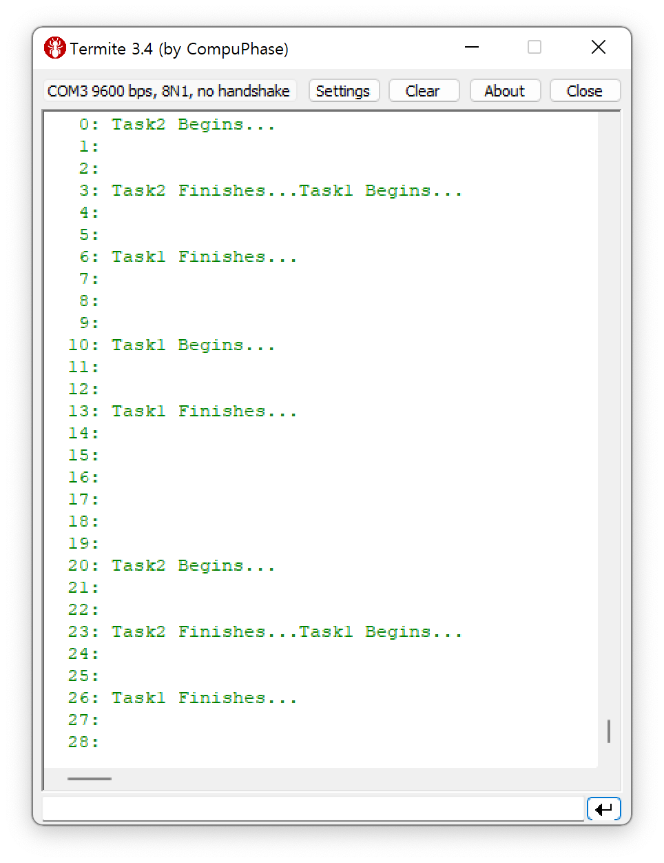
10. Alarm
Alarm을 이용한 주기적 Task 실행

Slide 8
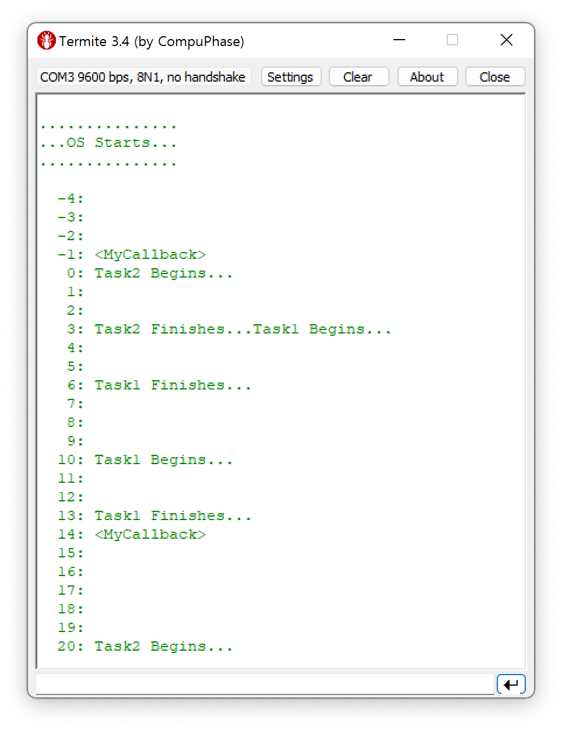
11. Alarm Callback
콜백 함수 등록
ALARMCALLBACK(MyCallback) {
printfSerial("MyCallback Begins...");
printfSerial("MyCallback Finishes...");
}
ALARM alarm3 {
COUNTER = mycounter;
ACTION = ALARMCALLBACK {
ALARMCALLBACKNAME = "MyCallback";
};
AUTOSTART = TRUE {
ALARMTIME = 5;
CYCLETIME = 15;
};
};

Slide 9
12. Event
TASK(Task2)
{
EventMaskType mask;
printfSerial("Task2 Begins...");
printfSerial("Task2 Waits...");
WaitEvent(Event1 | Event2);
printfSerial("Task2 Wakes Up...");
GetEvent(Task2, &mask);
if (mask & Event1) {
printfSerial("[Event1]");
ClearEvent(Event1);
}
if (mask & Event2) {
printfSerial("[Event2]");
ClearEvent(Event2);
}
printfSerial("Task2 Finishes...");
TerminateTask();
}

Slide 10
12. Event
ISR2(ButtonISR)
{
DisableAllInterrupts();
osEE_tc_delay(5000);
printfSerial("<BUTTON ISR>");
// read ADC value
unsigned int a0 = readADCValue(3);
if (a0 < 50) { // UP
SetEvent(Task2,Event1);
} else if (a0 < 200) { // DOWN
SetEvent(Task2,Event2);
} else if (a0 < 380) { // LEFT
} else if (a0 < 520) { // RIGHT
}
osEE_tc_delay(3000);
EnableAllInterrupts();
}
CPU_DATA = TRICORE {
ID = 0x0;
CPU_CLOCK = 200.0
MULTI_STACK = TRUE;
};
…
EVENT Event1 { MASK = AUTO; };
EVENT Event2 { MASK = AUTO; };
…
TASK Task2 {
PRIORITY = 2;
STACK = PRIVATE {
SIZE = 512;
};
SCHEDULE = FULL;
EVENT = Event1;
EVENT = Event2;
…

Slide 11
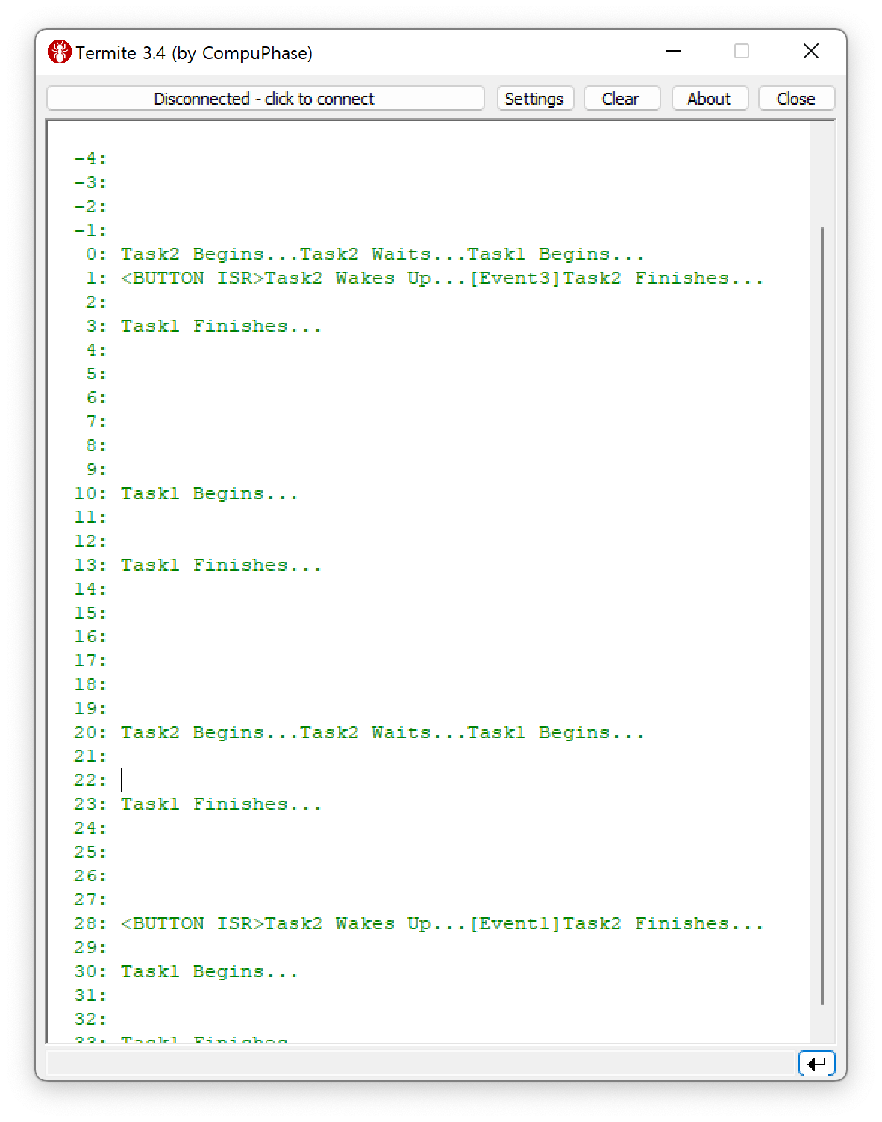
12. Event
ClearEvent는 왜 필요한가?
우선순위 반대의 경우 스케쥴링

Slide 12
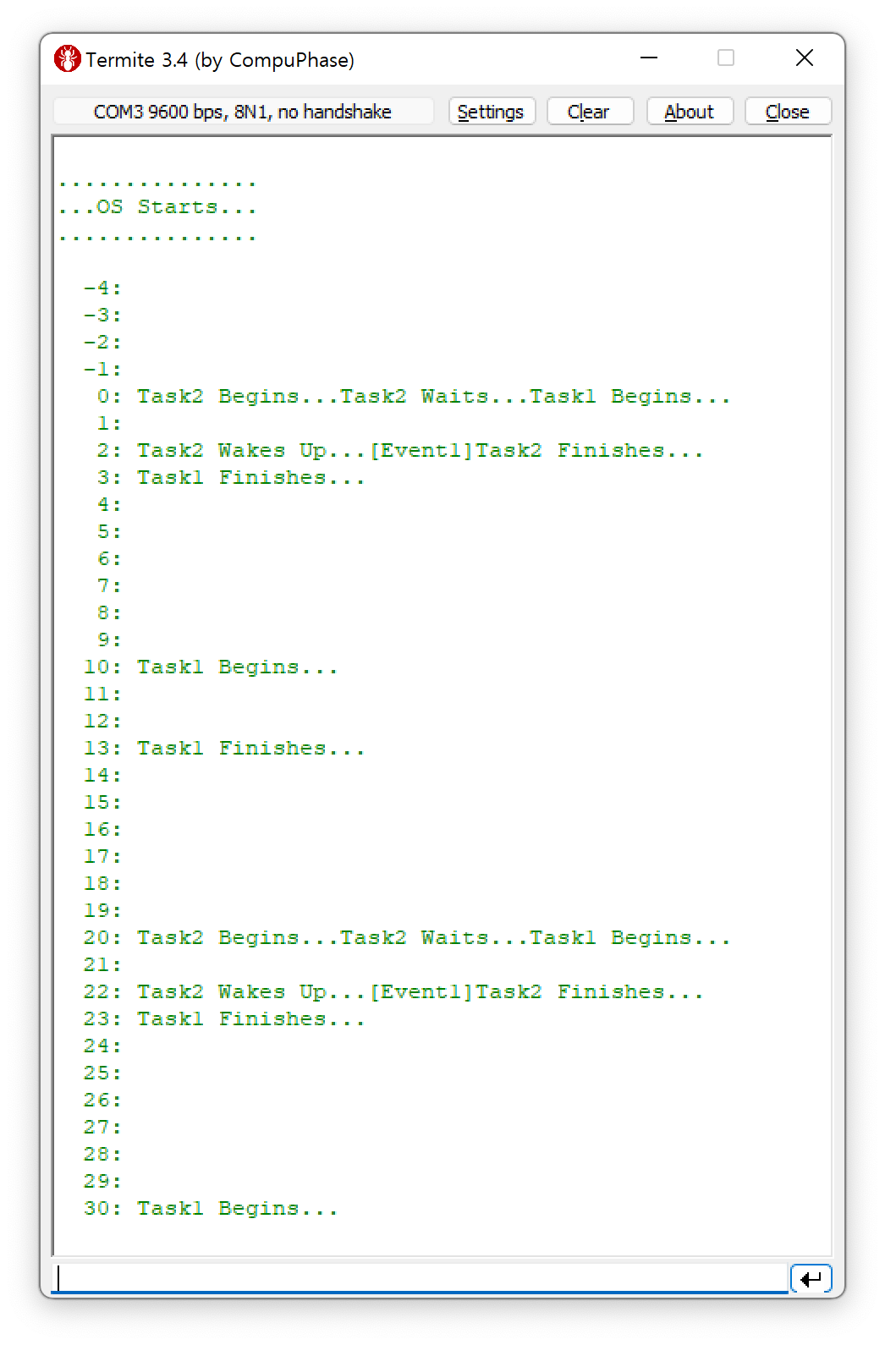
13. Alarm SetEVent
Alarm의 SetEvent Action
ALARM alarm3 {
COUNTER = mycounter;
ACTION = SETEVENT {
TASK = Task2;
EVENT = Event1;
};
AUTOSTART = TRUE {
ALARMTIME = 7;
CYCLETIME = 20;
};
};

Slide 13
14. Hook
…
KERNEL_TYPE = OSEK {
CLASS = ECC2; // Default
};
STARTUPHOOK = TRUE;
SHUTDOWNHOOK = TRUE;
PRETASKHOOK = TRUE;
POSTTASKHOOK = TRUE;
};
…
OIL 파일 Hook 설정
Alarm3 삭제
8번 예제의 printState() 추가

Slide 14
14. Hook
Task2 변경
8번 예제의 printState() 사용. 추가
TASK(Task2)
{
printfSerial("Task2 Begins...");
mdelay(3000);
printfSerial("Task2 Finishes...");
TerminateTask();
}

Slide 15
14. Hook
StartupHook
ShutdownHook
void StartupHook(void)
{
printfSerial("..StartupHook..\n");
}
void ShutdownHook(StatusType Error)
{
printfSerial("ShutdownHook...\n");
printState(Task1);
printState(Task2);
}

Slide 16
14. Hook
void PreTaskHook(void)
{
TaskType id;
GetTaskID(&id);
printfSerial("[PreTaskHook(%d)]", id);
printState(Task1);
printState(Task2);
}
void PostTaskHook(void)
{
TaskType id;
GetTaskID(&id);
printfSerial("[PostTaskHook(%d)]", id);
printState(Task1);
printState(Task2);
}
PreTaskHook
PostTaskHook

Slide 17
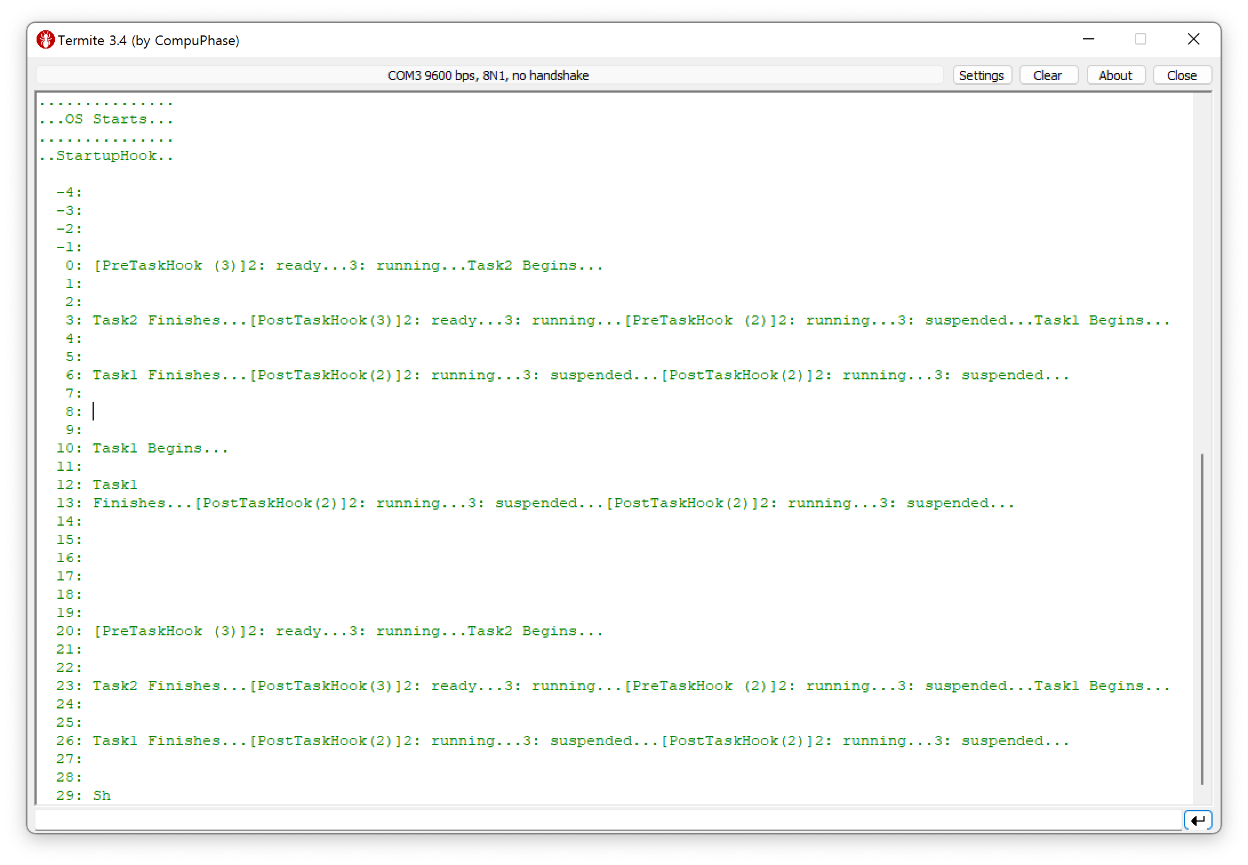
14. Hook

Slide 18
15. Error Handling
…
KERNEL_TYPE = OSEK {
CLASS = ECC2; // Default
};
STARTUPHOOK = FALSE;
SHUTDOWNHOOK = FALSE;
PRETASKHOOK = FALSE;
POSTTASKHOOK = FALSE;
ERRORHOOK = TRUE;
USEGETSERVICEID = TRUE;
USEPARAMETERACCESS = TRUE;
};
…
OIL 파일 설정
오류가 발생한 Service ID와 Parameter 정보 접근

Slide 19
15. Error Handling
ISR2(TimerISR)
{
osEE_tc_stm_set_sr0_next_match( 1000000U );
static long c = -4;
TaskStateType s;
if (c == 5) {
GetTaskState(30, &s);
}
IncrementCounter(mycounter);
printfSerial("\n%4ld: ", c++);
}
void ErrorHook(StatusType error)
{
printfSerial("[ErrorHook: error = %d, service = %d, TaskID = %d]",
error,
OSErrorGetServiceId(),
OSError_GetTaskState_TaskID());
}
Parameter 정보 접근 매크로
(ee_oo_api_osek.h)

Slide 20
15. Error Handling
E_OK, /* ((StatusType)0) */
E_OS_ACCESS, /* ((StatusType)1) */
E_OS_CALLEVEL, /* ((StatusType)2) */
E_OS_ID, /* ((StatusType)3) */
E_OS_LIMIT, /* ((StatusType)4) */
E_OS_NOFUNC, /* ((StatusType)5) */
E_OS_RESOURCE, /* ((StatusType)6) */
E_OS_STATE, /* ((StatusType)7) */
E_OS_VALUE, /* ((StatusType)8) */
E_OS_SERVICEID, /* ((StatusType)9) */
E_OS_ILLEGAL_ADDRESS, /* ((StatusType)10) */
…
OSServiceId_ActivateTask = (0),
OSServiceId_TerminateTask = (2),
OSServiceId_ChainTask = (4),
OSServiceId_Schedule = (6),
OSServiceId_GetTaskID = (8),
OSServiceId_GetTaskState = (10),
OSServiceId_DisableAllInterrupts = (12),
OSServiceId_EnableAllInterrupts = (14),
OSServiceId_SuspendAllInterrupts = (16),
OSServiceId_ResumeAllInterrupts = (18),
OSServiceId_SuspendOSInterrupts = (20),
OSServiceId_ResumeOSInterrupts = (22),
…
ee_api_types.h

Slide 21
15. Error Handling
/**
* \brief This macro returns the TaskID parameter passed to ActivateTask().
* \ingroup primitives-hook
*/
#define OSError_ActivateTask_TaskID()\
((TaskType)osEE_get_api_param1().num_param)
/**
* \brief This macro returns the TaskID parameter passed to ChainTask().
* \ingroup primitives-hook
*/
#define OSError_ChainTask_TaskID()\
((TaskType)osEE_get_api_param1().num_param)
/**
* \brief This macro returns the TaskID parameter passed to GetTaskID().
* \ingroup primitives-hook
*/
#define OSError_GetTaskID_TaskID()\
((TaskRefType)osEE_get_api_param1().p_param)
ee_oo_api_osek.h

Slide 22
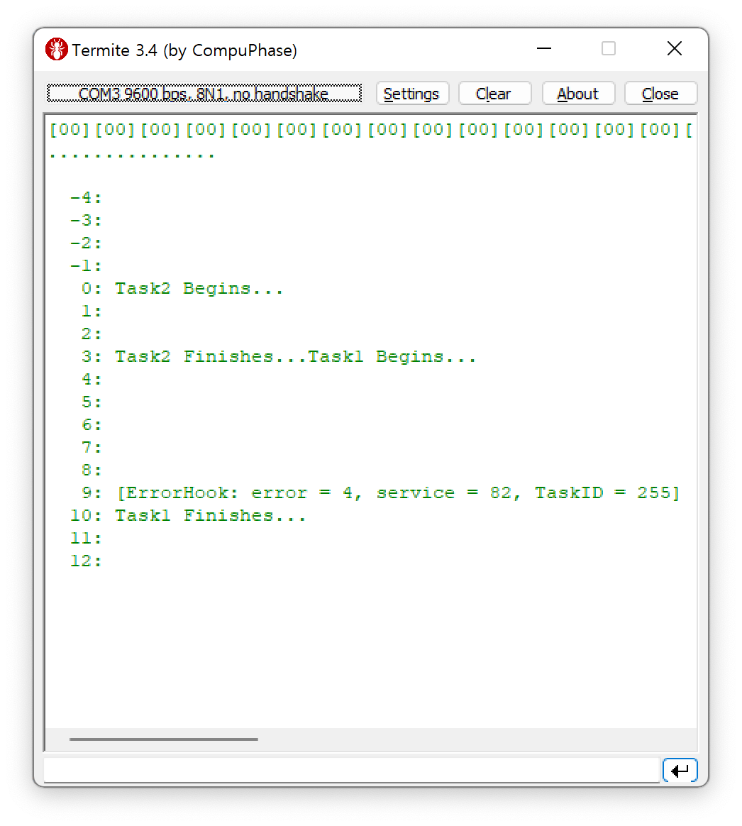
16. Deadline Miss
ISR2(TimerISR)
{ osEE_tc_stm_set_sr0_next_match( 1000000U );
static long c = -4;
IncrementCounter(counter1);
printfSerial("\n%4ld: ", c++);
}
TASK(Task1)
{
TaskType id;
printfSerial("Task1 Begins...");
mdelay(7000);
printfSerial("Task1 Finishes...");
TerminateTask();
}
Kernel Internal Error
이 경우 Task1의 Deadline Miss
: Activation 수 초과

Slide 23
Questions

